Slide 1

Machine Learning (19CSE305)
Term Project:<<Group-13>>
Project Title: <<Sports Prediction>>
Department of Computer Science & Engineering,
Amrita School of Engineering, Bengaluru

Slide 2
Agenda
Problem statement & Data Description
Techniques tried and justifications
Results and interpretation
Conclusion

Slide 3
Introduction
Problem Statement
The problem we are dealing with is related to the game of cricket in which we will be predicting the average score of different batsmen based on the previous statistics. From this prediction we can make assumptions on batsmen’s individual score in future matches.
Data Description
The data we using are total individual runs of batsmen, number of times he got out, total number of matches he played and his individual strike rate.
Here individual strike rate is dependent attribute which is dependent on all other attributes.
We have taken this data from the previous matches statistics from all seasons of IPL.
We performed data cleaning on our dataset to remove null values and irrelevant data from our data set.

Slide 4
Technique Description
The algorithms used are:
Support Vector Machine (SVM)
K-NN classifier
Decision Tree
Linear Regression
Logistic Regression
Naive bayes
For SVM and k-NN first we append 2 features(total runs and total outs) into a single array and then we divided batsman average in 2 different classes and we passed those classes and the array into SVM and K-NN classifiers .
For decision tree we introduced an other feature no. of balls and append all the 3 features to a single array and we took the classified average and passed them into decision tree model.
In both linear and logistic regression we considered only one feature(total runs) for prediction so the accuracy achieved is very low because for our data prediction requires 2 features.
In Naïve Bayes first we append 2 features(total runs and total outs) into a single array and then we round off the average attribute and pass it to Naive Bayes model.

Slide 5
Technique Description
Beyond lab work –
Random forest - A Random Forest operates by constructing several decision trees during training time and outputting the mean of the classes as the prediction of all the trees.
The features we used to train this model are no. of balls, outs, no. of runs and average.
Here average is the dependent variable, it is dependent on all other variables.
We used 70% of data to train the model and the rest 30% of data to test the model
We found the accuracy to be around 94% while using this model.

Slide 6
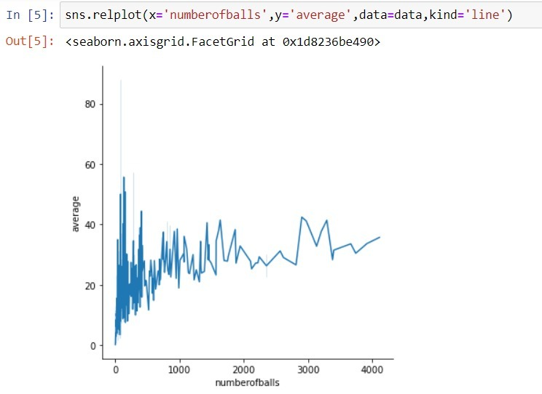
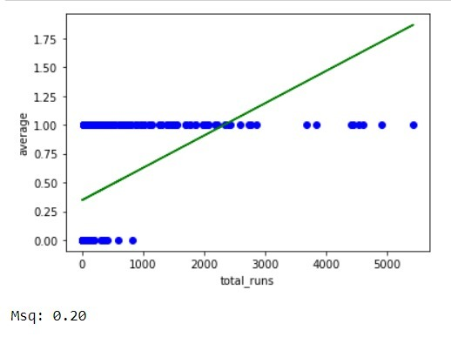
Results & Discussion
Some useful plots –
Linear regression

Slide 7
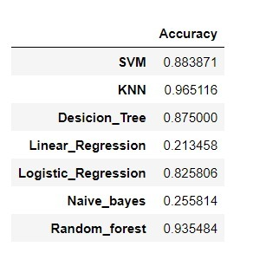
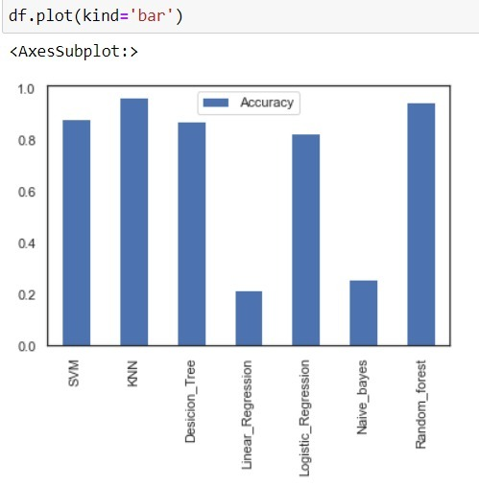
Results & Discussion
Accuracies we obtained from different algorithms
On comparing the accuracies in the graph we can see that k-NN has the most accuracy , by this we conclude that K-NN classifier is best fit for our data set and prediction.

Slide 8

Thank you !!!!!

